Slide 1


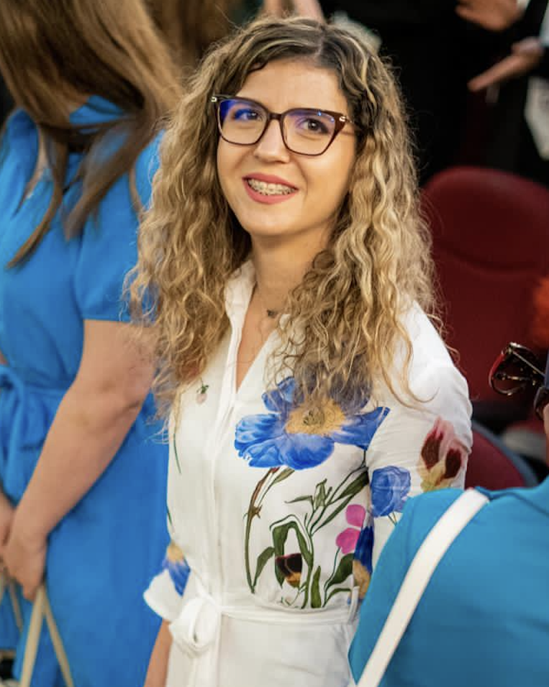
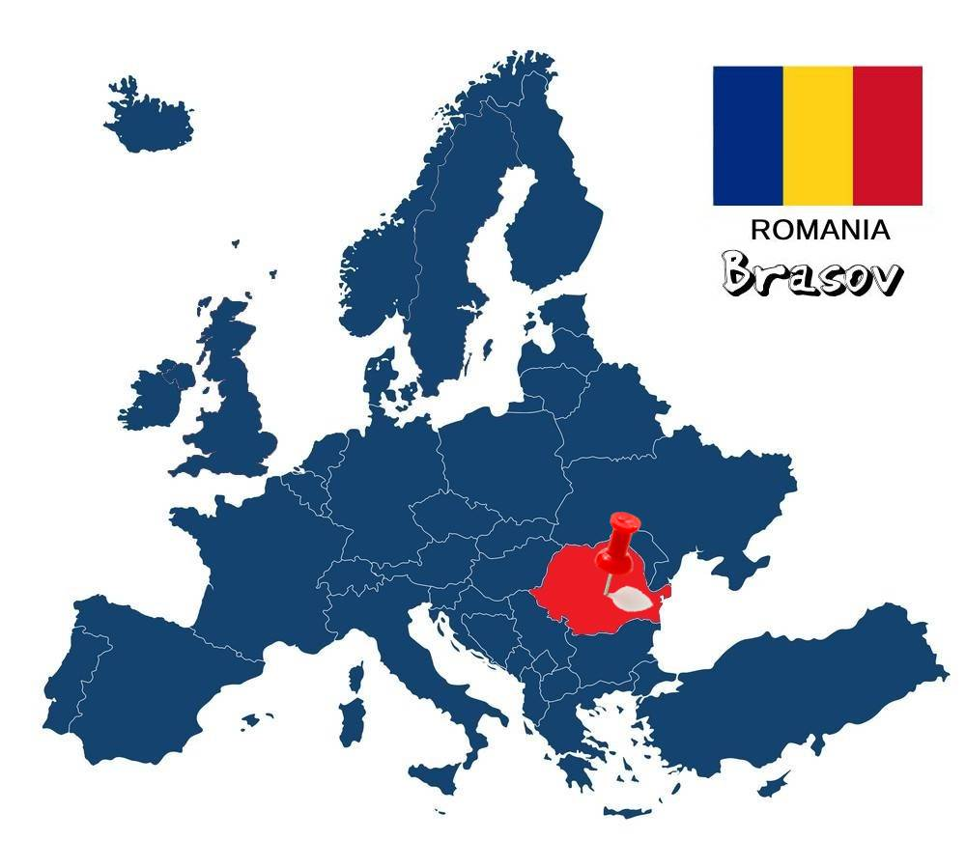

University: Transilvania University of Braşov, Faculty of Food and Tourism / University of agricultural sciences and veterinary medicine Bucharest, Faculty of Biotechnology
Study program: Biotechnology
Year of study: 4th year of PhD
City: Braşov, Bucharest, Romania
Motto for life: Grow through research, give through teaching.
Hobbies: sports, travelling, hiking and spending time in nature.
Your expectations from the summer school:
I hope to learn more about sustainable food systems, share ideas with others, and gain practical ways to promote sustainability in research, teaching, and everyday life.

